Slide 1
PLANT DISEASE DETECTION USING AI
EMPOWERING AGRICULTURE WITH CNN
Presented by:-
CHINMAYEE MAHARANA

Slide 2
INDEX
Interdiction to agriculture and challenges
What our model offers
About our model
Importing dataset
Preparing the data for training
Architecture of the model(cnn)
Model summary
Training the model
visualize the model's performance
Image Prediction Using Trained Model
Example

Slide 3
INTRODUCTION TO AGRICULTURE AND CHALLENGES
1. Why Agriculture Matters
Agriculture is the foundation of food security, livelihoods, and global economies—impacting billions of lives daily. But how can we make it more efficient and sustainable?
2. What Are Farmers Up Against?
Farmers face real challenges: delayed disease detection, lack of expert guidance, overuse of pesticides, and limited access to technology. These issues can lead to crop losses and financial strain. What if there was a better way to solve this?
3. How Can Our application Help?
Our app detects plant diseases in real time, offers expert-level analysis, and provides actionable insights—all from your phone. Imagine being able to take quick, informed action to protect your crops, reduce pesticide use, and boost yields—right at your fingertips.

Slide 4
WHAT OUR MODEL OFFERS
AI Leverages Data for Smarter Farming
Ever wondered how data and algorithms can boost farming? AI uses data, machine learning, and algorithms to make farming more efficient and productive!
Accurate & Efficient Disease Detection
What if you could spot diseases before they spread? AI analyzes crop images and data quickly and accurately, enabling early action to save your crops.
Reducing Manual Labor
Imagine automating tasks like monitoring crop health. AI tools take care of routine checks, reducing the need for constant inspections and saving you time and effort.
24/7 Availability—Anytime, Anywhere
Think about this: Real-time disease diagnostics, available day or night, even in remote areas. AI systems work around the clock to provide instant insights, no matter where you are.

Slide 5
ABOUT THE MODEL
The model is a tool that’s trained on thousands of plant images and disease data. Our model uses this vast dataset to identify plant diseases with exceptional accuracy, helping you detect issues early.
The model is trained by CNN deep neural network to classify the plant disease.
It has an interface where we can upload image of plant leaves. And learn what the plant is suffering from.

Slide 6
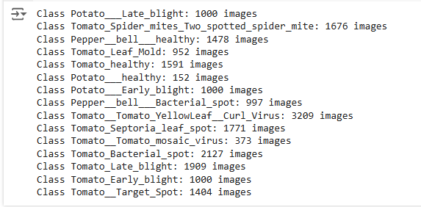
IMPORTING DATASET
Importing Data from Kaggle
First, I mount my Google Drive to access and store files directly from Google Colab.
Then, I install the Kaggle API using !pip install Kaggle and authenticate with my kaggle.json file to securely connect to my Kaggle account.
Finally, I download the “emmarex/plantdisease” dataset directly from Kaggle using the Kaggle API, so I can use it in my model within Colab.“
"Let’s dive into the Plant Disease dataset!
there nuber of class: 15

Slide 7
PREPARING THE DATA FOR TRAINING
we are splitting the PlantVillage dataset into training, validation, and test sets to ensure proper model training and evaluation.
First, we define paths for the train, val, and test directories and create them if they don't exist. The images are then shuffled to ensure randomness, and we calculate the split ratios (70% for training, 15% for validation, and 15% for testing).
After determining the split points, the images are copied into their respective directories. This process helps ensure that the model is trained on diverse data and evaluated on unseen samples, promoting better generalization.
we use TensorFlow and Keras to preprocess and augment the dataset for training. We begin by defining the image size (224x224) and batch size (32).
ImageDataGenerator, is applied to create various augmentations to the training set, These augmentations create more diverse images, which help the model generalize better and reduce overfitting. For the validation and test sets, we only apply rescaling (dividing by 255) to normalize the image pixel values
The flow_from_directory() method is used to load images from their respective directories. TensorFlow handles the data loading efficiently, and shuffle=False for the test set ensures the order of images is preserved during evaluation.

Slide 8
ARCHITECTURE OF THE MODEL (CNN)
we define a Convolutional Neural Network (CNN) using TensorFlow and Keras for image classification.
The model consists of:
Convolutional Layers: The model has four Conv2D layers with increasing filters (32, 64, 128, 256) and ReLU activation, followed by MaxPooling2D to reduce the spatial dimensions
Flattening: After the convolutional layers, we flatten the output to create a 1D vector for the fully connected layers.
Fully Connected Layers: Two Dense layers with 256 units and ReLU activation are added to learn complex features.
Dropout: To prevent overfitting, a Dropout layer with a rate of 0.3 is used.
Output Layer: A final Dense layer with softmax activation outputs the classification probabilities, with num_classes (15) categories.
The model is compiled using categorical crossentropy as the loss function and Adam optimizer. Finally, the model summary is displayed to show the architecture details.

Slide 9
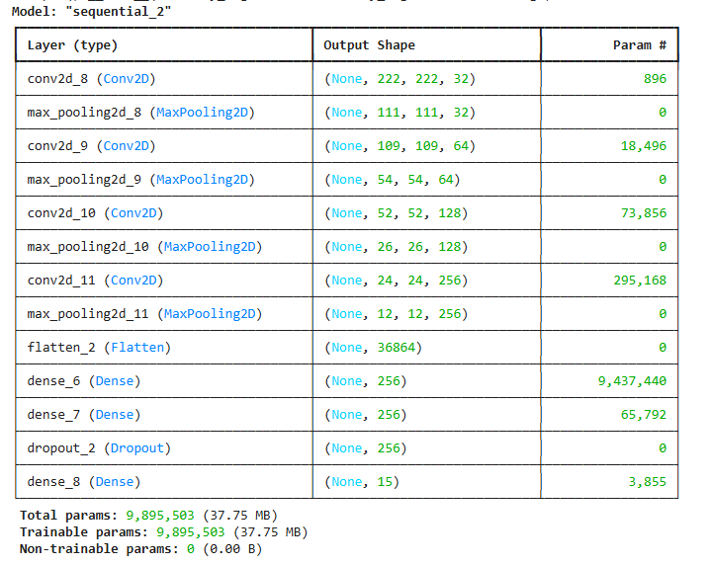
MODEL SUMMARY
The total parameters are the sum of the parameters from all layers. These are the trainable weights and biases that the model learns during training.

Slide 10

TRAINING THE MODEL
Train the Model:
Use model.fit() to train the model with training data (train_generator).
Set epochs to 10 and calculate steps_per_epoch and validation_steps based on batch size.
Validate the model with val_generator during training.
Evaluate on Test Set:
Use model.evaluate() to assess the model on the test set (test_generator).
After the epochs were completed. We got the following loss and accuracy value:
saves the trained model to a file named 'PlantVillage.h5', which allows you to reload the model later for inference or further training without retraining it from scratch.

Slide 11
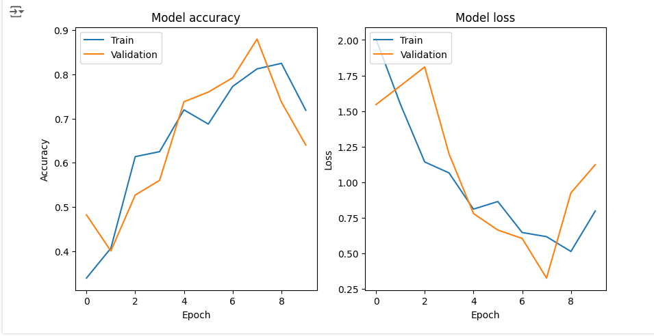
VISUALIZE THE MODEL'S PERFORMANCE
visualize the model's performance during training and validate its learning progress.

Slide 12
IMAGE PREDICTION USING TRAINED MODEL
we first load the trained model from the file 'PlantVillage.h5’.
Then, we define a function to preprocess the uploaded image by resizing it, converting it to an array, normalizing it, and preparing it for prediction.
The image is uploaded from the local machine using files.upload().
After preprocessing, we use the model to predict the class of the uploaded image.
We retrieve the class labels (the categories of the dataset) from the train_generator.
The uploaded image is displayed using matplotlib, with the predicted class as the title.

Slide 13
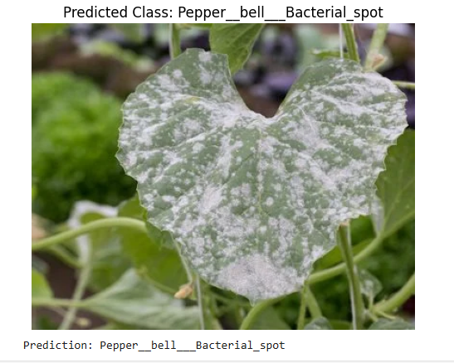
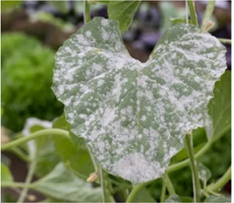
EXAMPLE
After uploading an image, the model predicts:

Slide 14
THANKYOU

